Slide 1
tMN vs Cancer Patient - Lab Result Elements Preliminary Analysis Overview
Zijun Wu
Data Patterns and Trend Visualization Reports
Nov 6, 2023

Slide 2
Agenda
Problem Statement
Data Profile
Data Processing
Data problems and difficulties & solutions
19 features introduction
General Tendency and Individual Images
Proposed Solution and Model Selection
Conclusion & Future Steps
2
Notes:
Of my presentation

Slide 3




Problem Statement
tMN prediction is a race of time
tMN Is a race of time to predict the acute disease before
As the potential patients approaching to the critical transition point, more signs are showing on their body, but they becoming more and more vulnable to the transition to tMNs.
The primary objective of analyzing this dataset is to understand the hematological profiles of patients, particularly in relation to the diagnosis of tMN.
This involves exploring trends, patterns, and potential indicators within the hematological parameters leading up to the diagnosis date.
The lab data provides a high-level overview of the data, including patient information, hematological parameters, and temporal aspects, setting the stage for further exploration and analysis.
0.5%-1% cancer will become tMN patients, the longest latency could be 7 years.
Find out how to target these tMN patients
before the diagnosis
Therapy related leukemia progresses rapidly, and patients may face a life-threatening situation within a month.
Devise a time-efficient prediction model capable of delivering predictive outcomes prior to diagnosis
Notes:
the onset of therapy-related leukemia in potential tMN patients.
A race of time

Slide 4



Data Profile
The dataset comprises 48,732,425 records capturing diverse hematological parameters across numerous patient encounters.
Each record provides insight into a patient's health status based on hematological measurements during a specific encounter.
Time-based information allows for the exploration of how hematological parameters relate to the diagnosis date and the time intervals leading up to the diagnosis.
Data Dimension | Descriptions
Data Variables | from 97,000 cancer patients, including 217 tMN patients
Data Size | 5 million records after cleaning duplicates
Data Type | Time-based numerical data, categorical data
Target | 19 categories hematological parameters
Notes:
Data introduction

Slide 5




Pre-Data Processing
Multi-layer filtering to get tMN patients.
Data Problems:
1. No CHIP category, filtering out using indicators or other features
2. Don’t have much before and after chemotherapy indicator differences or comparison (lack of relevant key features)
3. Dates of each leukemia treatment
No classification of tMN patients. Filtering out based on conditional filtering on 514600 diagnosis records.
Filtering 217 out of 97,000 patients
Create relevant key features

Slide 6
Difficulties
Limited Temporal Data:
Dynamic Nature of the Disease:
Rapidly progressing diseases often have a short timeframe between diagnosis and critical events (e.g., death).
This results in a limited amount of temporal data available for model training and challenges to capture the dynamics of disease progression adequately.
Rapidly progressing diseases can exhibit dynamic and unpredictable patterns, making it difficult to model and predict the disease trajectory accurately.
Changes in patient condition may occur rapidly, and capturing these nuances in the data is challenging.
Imbalanced Data:
Limited Feature Stability:
The dataset may be imbalanced, with a small number of instances representing the critical events (e.g., death) compared to non-critical events.
This imbalance can affect model performance, as the algorithm may be biased towards predicting the majority class.
Features that are relevant early in the disease progression might lose their significance as the disease advances.
Identifying stable features that provide consistent predictive power throughout the progression becomes a challenge.

Slide 7
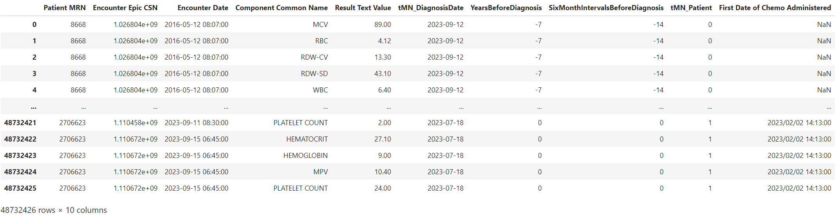
Raw Data
Data quantity: 5 million records
Sample Quantity: 91,402 patients
Time window: 2016 to 2023
7

Slide 8
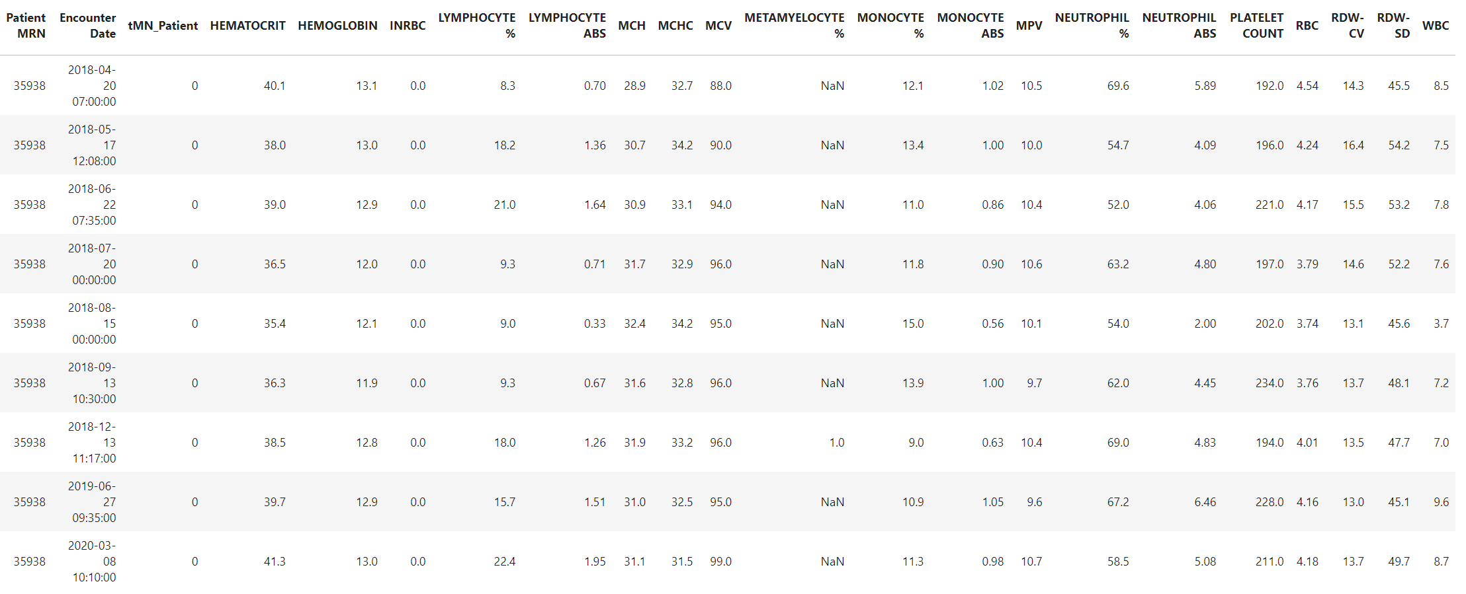
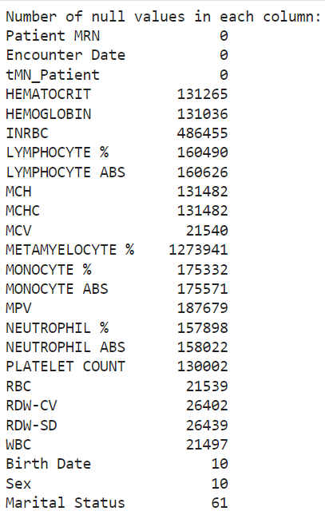
Data Transform
Transform into column values
Add age and several indicators
Null value cleaning

Slide 9
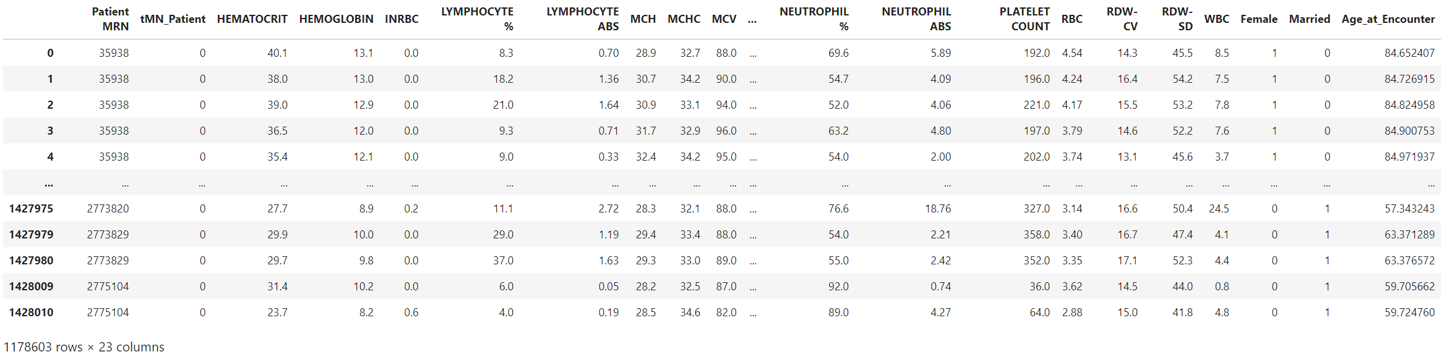
Data Cleaning
Broken records
Null values
Falsely calculated results

Slide 10
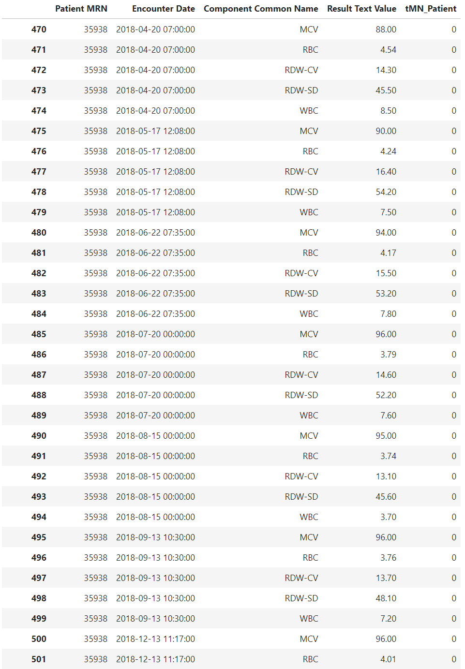
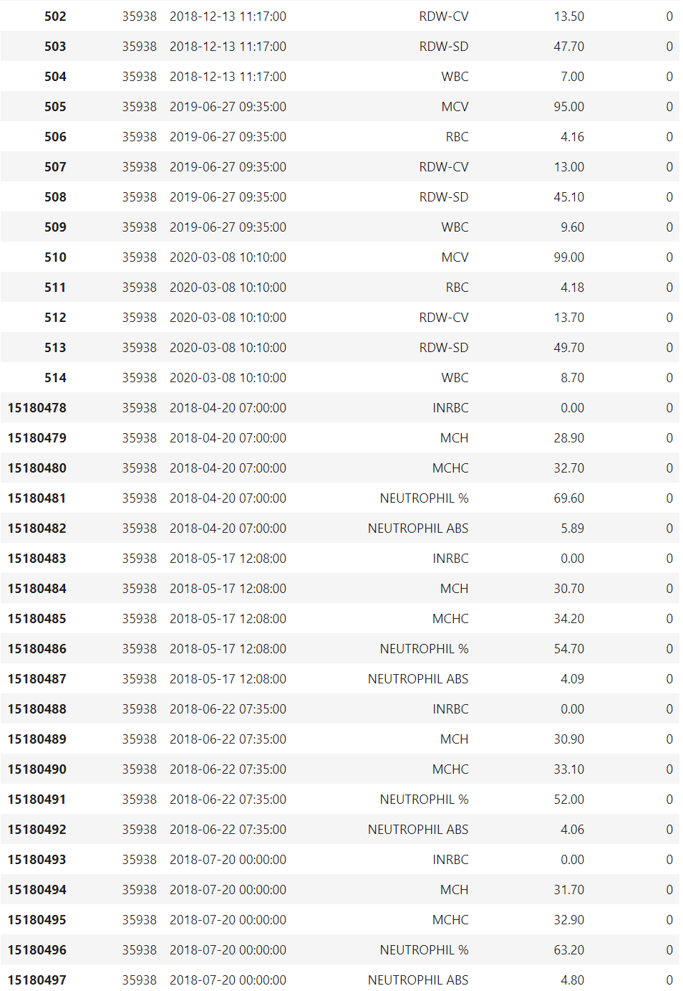
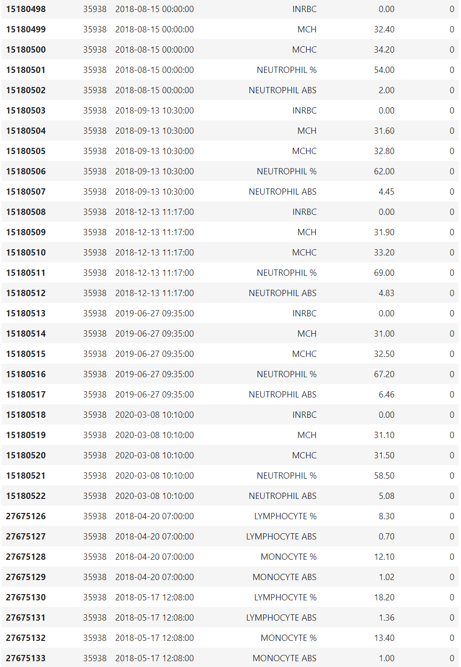
Sample Patient Record - MRN xxxxx

Slide 11
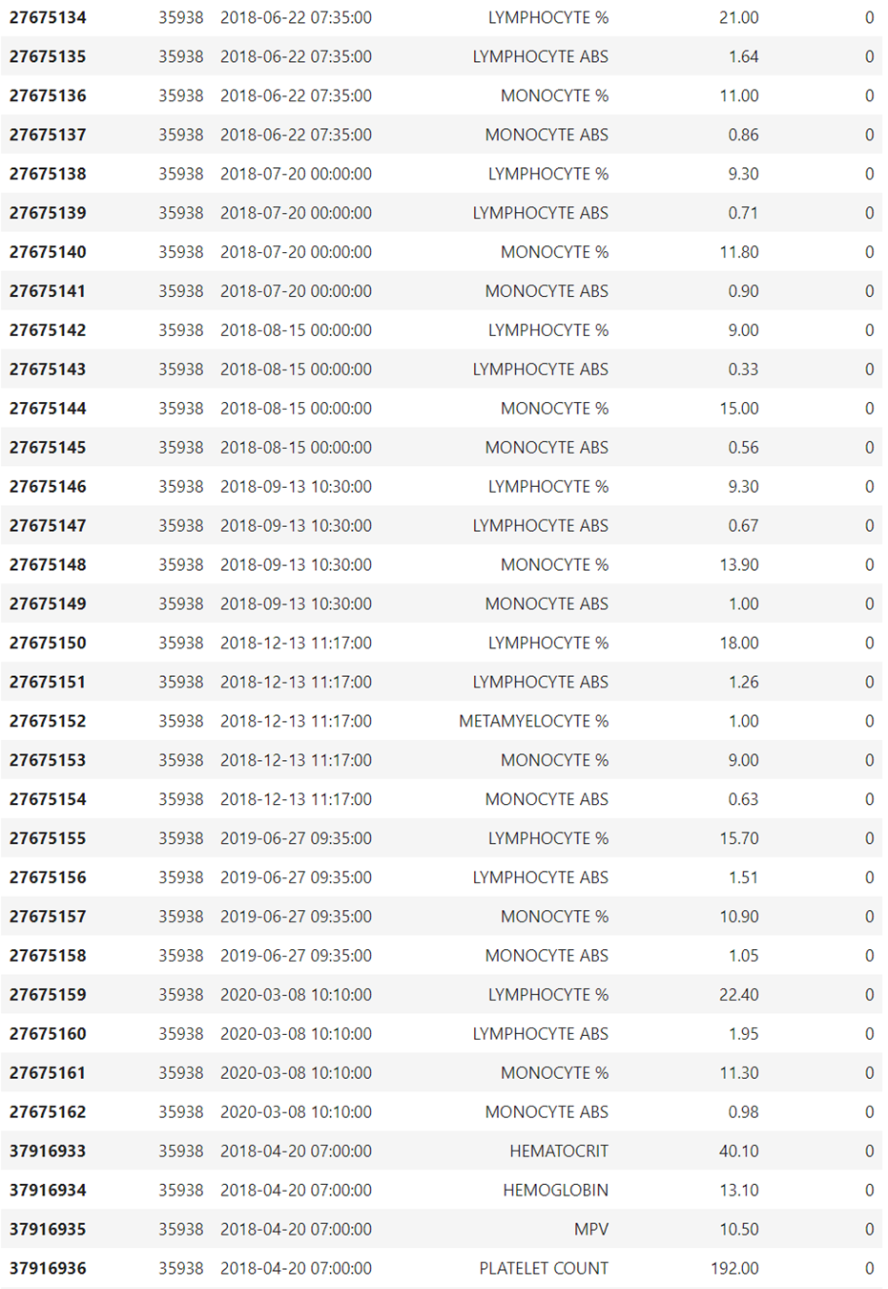
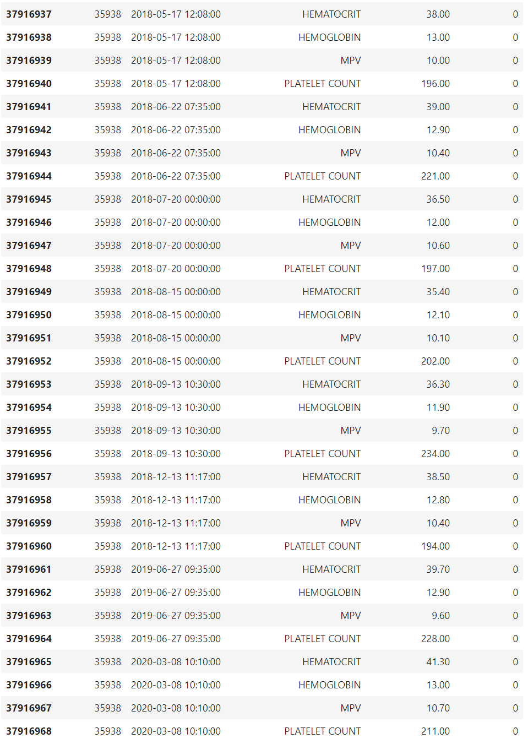
Sample Patient Record - MRN xxxxx
Each date and time specific records
Hematological test classification
Test result values – Average repetition values

Slide 12
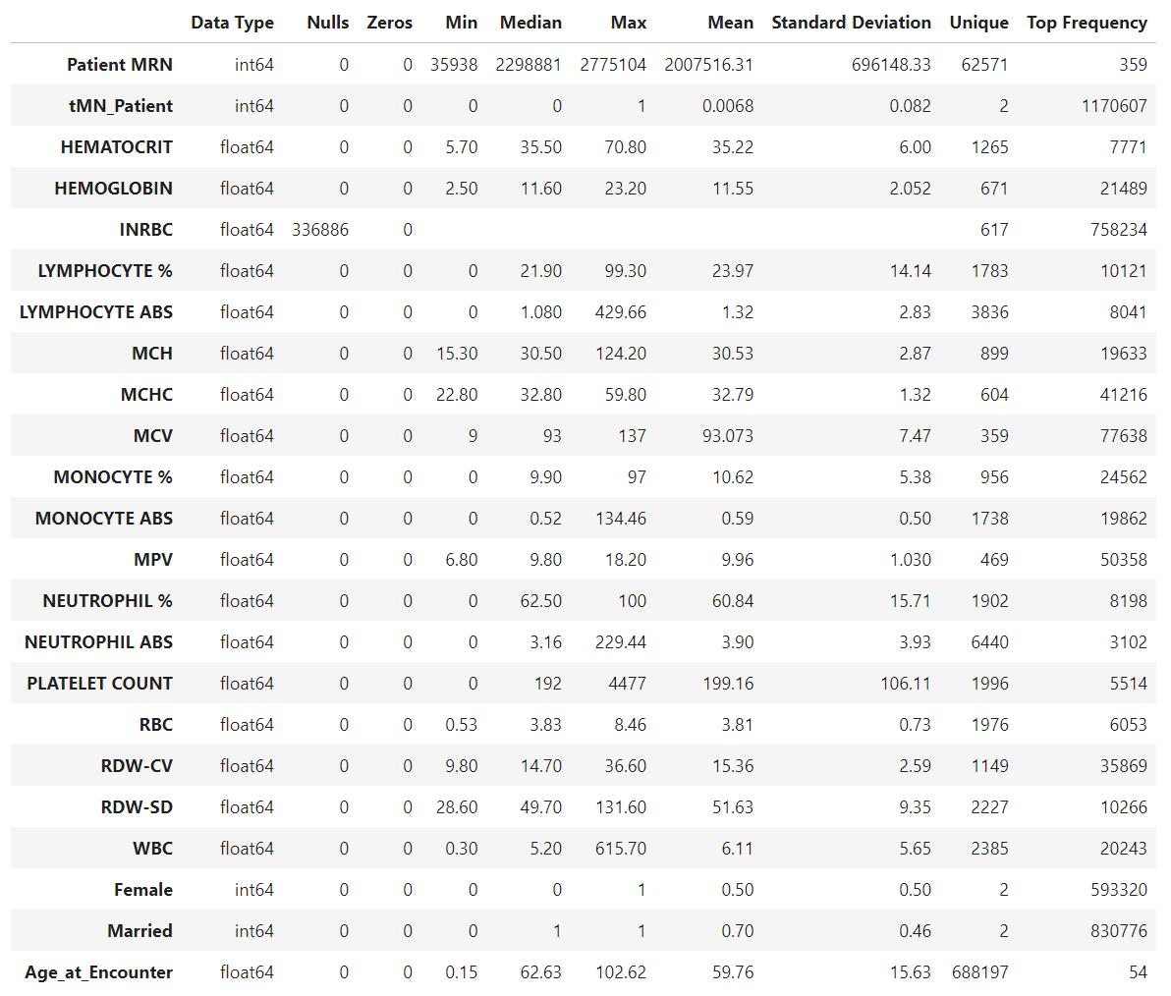
Detail Data Profile
Lab test categories are mainly numerical after transformations.
Age is detailed with decimals to capture changes within one year, resulting in the highest number of unique values.
HGB has highest SD
Top frequency in lab test category item is INRBC for having 75,8234 values for having most 0 values. Second highest is MPV, we expect a lot of repetition values.

Slide 13
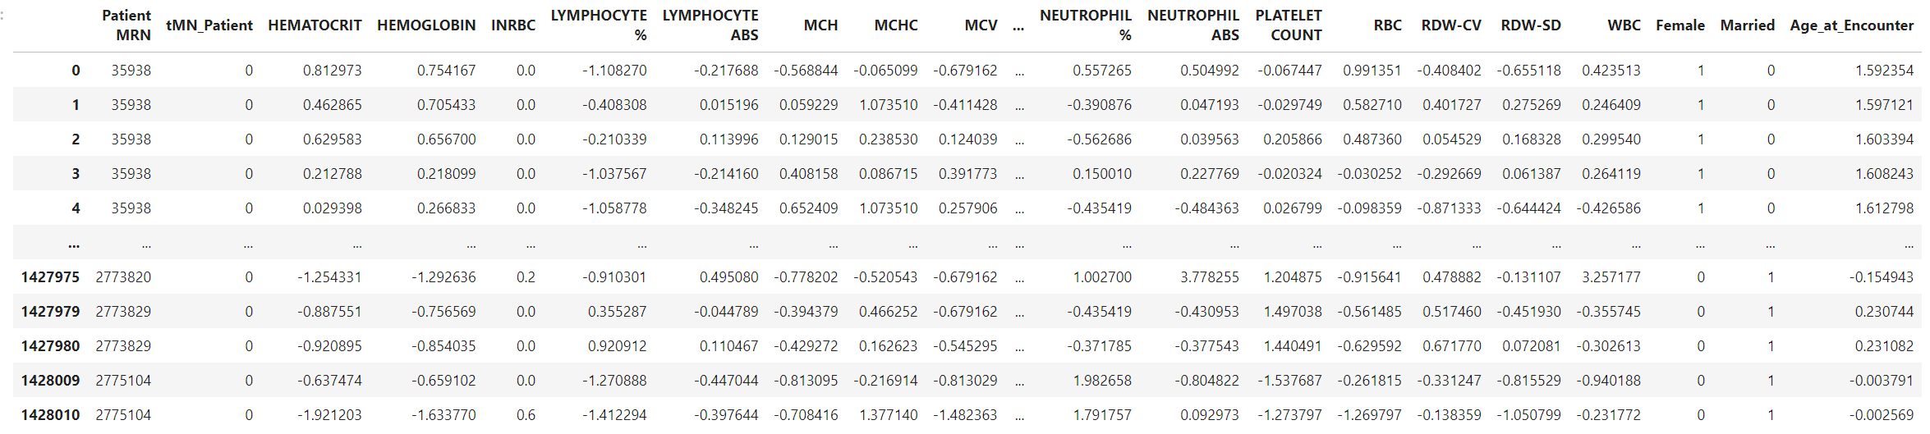
Scaling

Slide 14
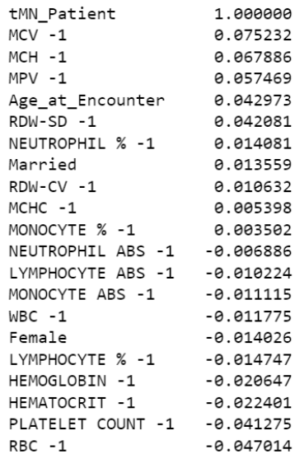

Slide 15
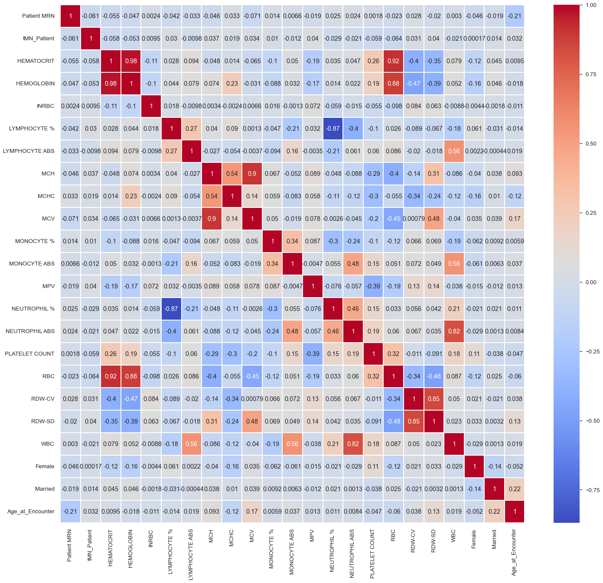
Correlation Matrix
Relationship Strength and Directions:
HCT, HGB, PLT, RDW-CV
Multicollinearity:
Positive correlation (closer to 1):
WBC & NEUT ABS
RDW-SD
MCV & MCH
HCT & RBC & HGB
Negative correlation (closer to -1):
NEUT% & LYMPH%
Notes:
2. So not necessarily the result of

Slide 16
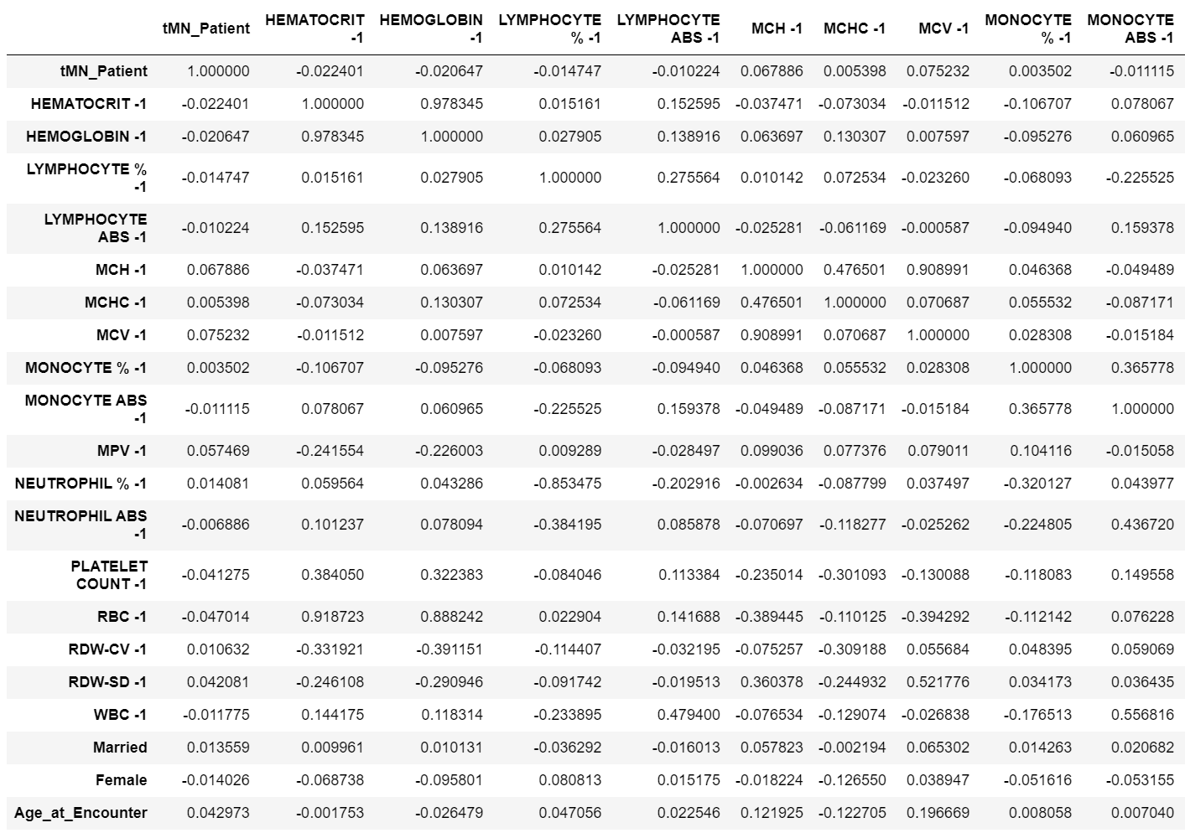
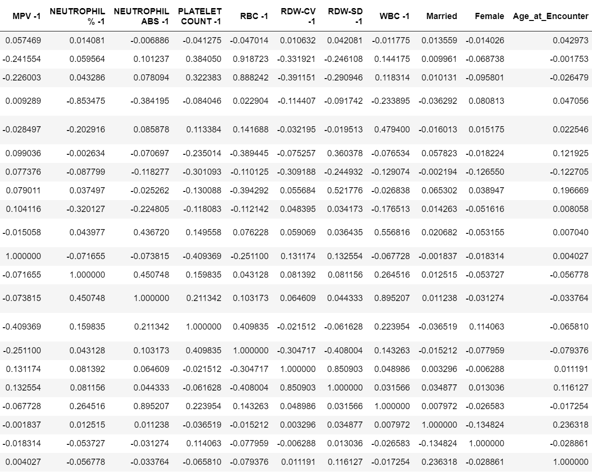
12.18

Slide 17
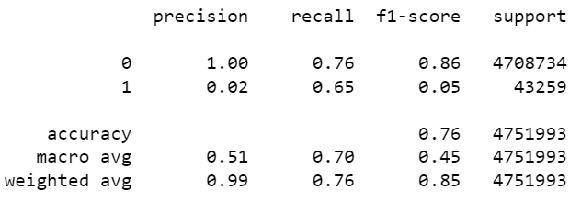
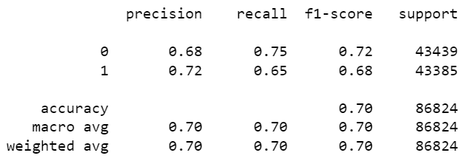
12.18

Slide 18
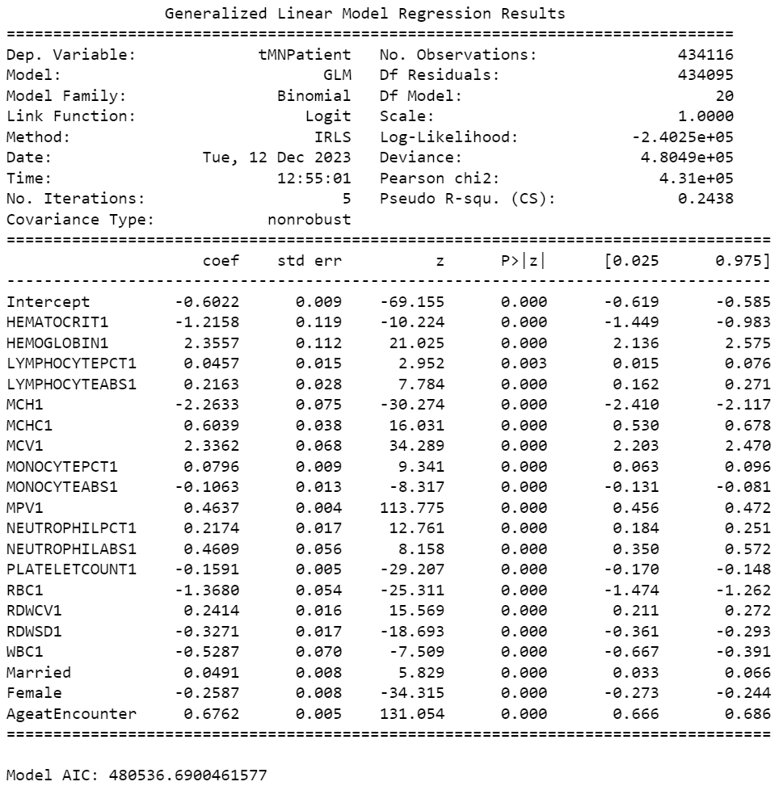
12.18
GLM MODEL

Slide 19
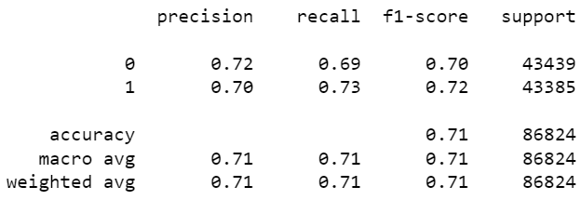
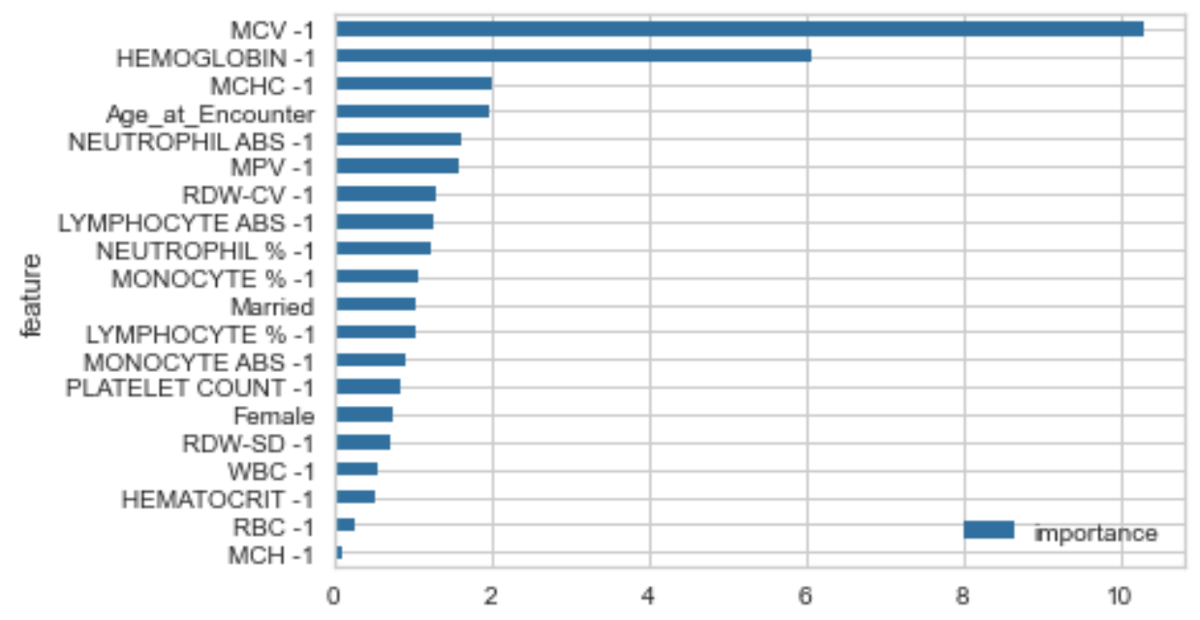
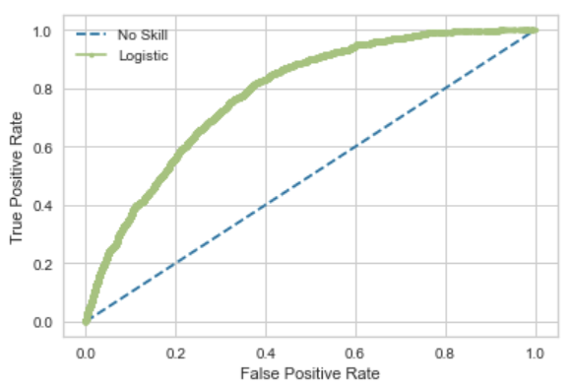
12.18 Logistic Regression

Slide 20
12.18 Comparison

Slide 21
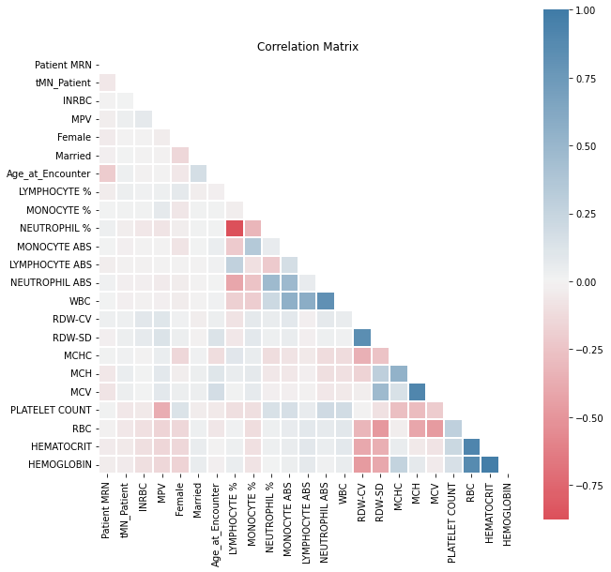
All - Correlation Matrix
Multicollinearity:
Positive and Negative correlation pair exist
Identification of Patterns:
Clusters or patterns of high correlation among groups of features may indicate underlying structures in the data.
Potential Redundancy:
High correlation between two features may indicate redundancy, and one of them could potentially be excluded to simplify the model.

Slide 22
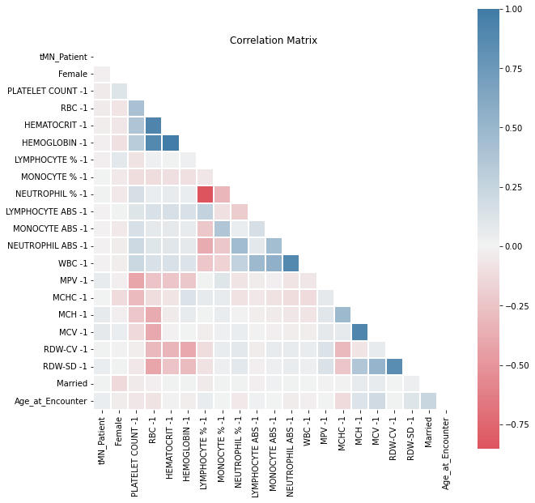
N1 - Correlation Matrix
Stronger Multicollinearity:
-1 period element correlation has more positive and negative correlation pairs exist
The latest 6-month data shows comparatively stronger correlations between feature pairs compared to the feature pairs in the whole 7-year dataset
Indicates a change or a shift in the underlying patterns or relationships between those features

Slide 23
N1 - Correlation Matrix
Potential Reasons
Intervention or Treatment Effects:
Significant events or interventions within the last 6 months, such as chemotherapy treatments. Positive correlations may arise as a result of the therapeutic interventions.
Pre-Diagnostic Changes:
Changes in blood indicators occurring in the months leading up to leukemia diagnosis may be reflective of early signs or manifestations of the disease before clinical diagnosis.
Side Effects of Medications:
Cancer treatment medications may have effects on various blood parameters.
Positive correlations emerge if specific medications impact multiple indicators in a consistent manner.
Seasonal Variations:
Capturing partial pattern of seasons (Summer with higher temperature and different environment factors)

Slide 24
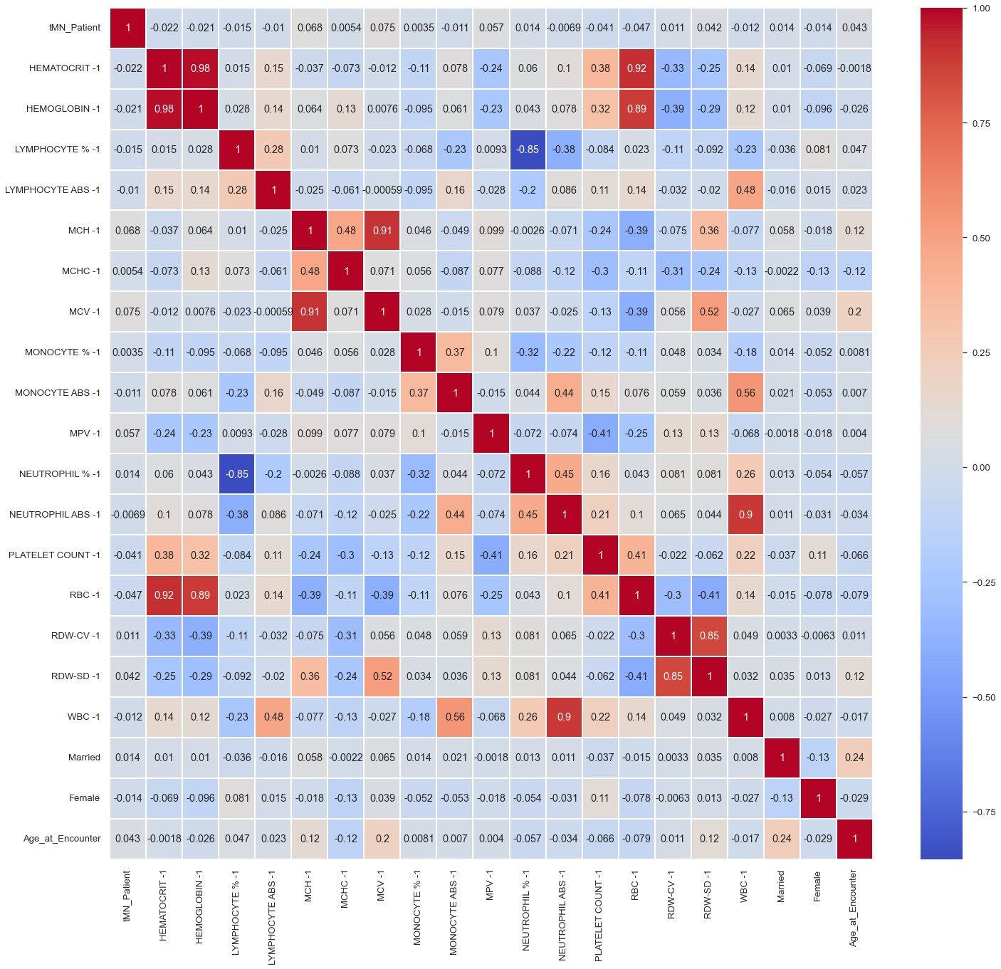
Overall Trend
There are positive and negative changes at the same time
But slightly variations

Slide 25
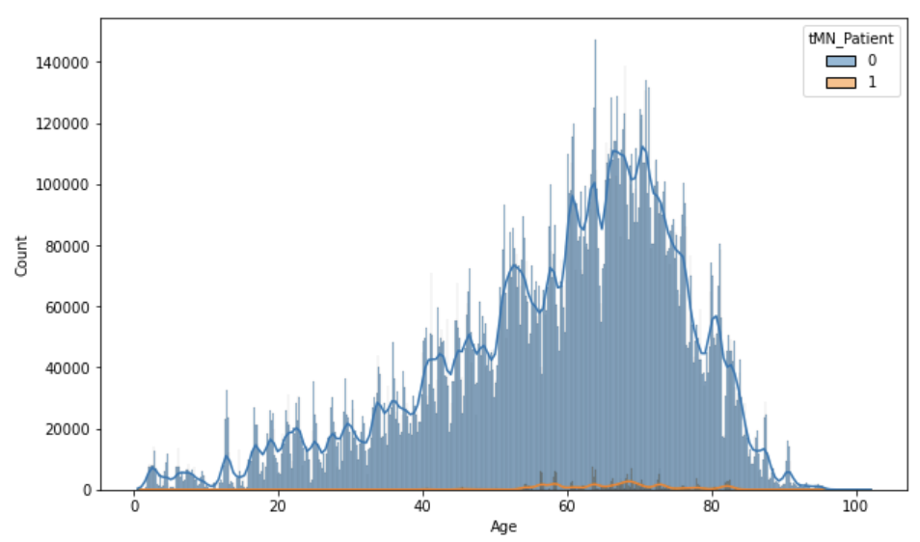
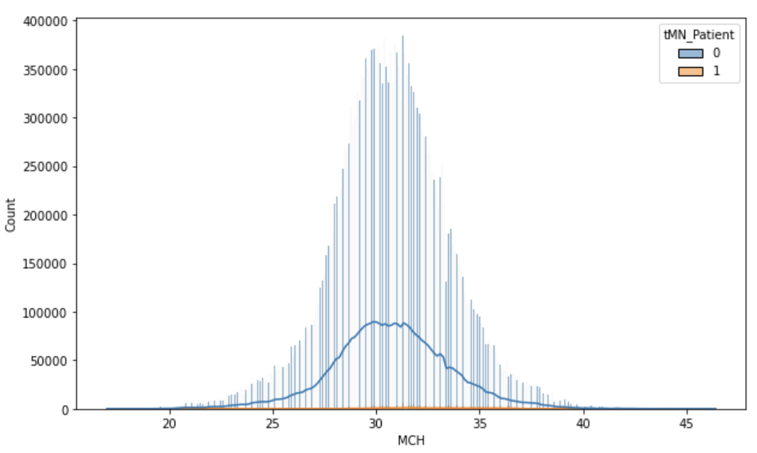
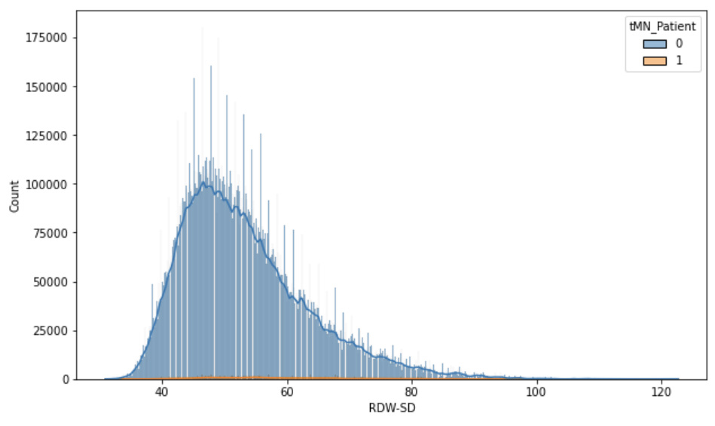
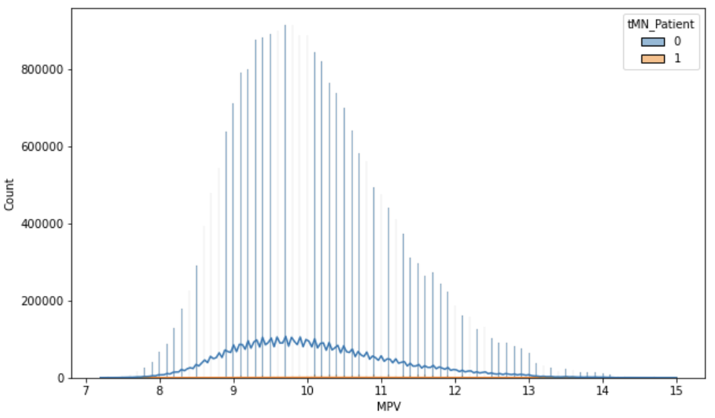
Age 50-83, peak around 70 years old
Notes:
More fluctuations in data, not generating a smooth line
Special patterns in MPV

Slide 26
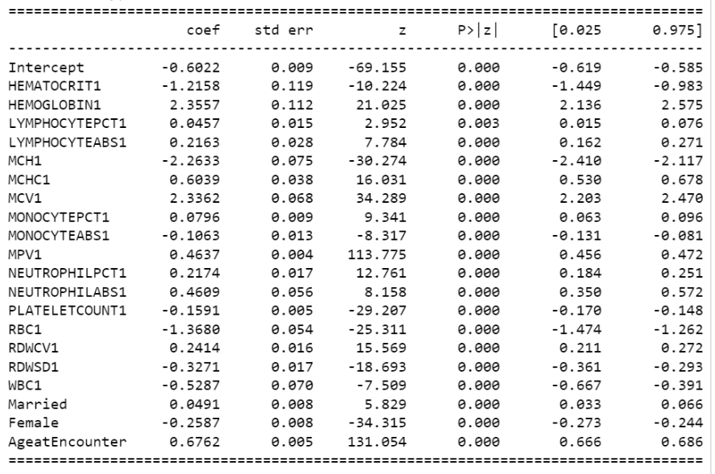
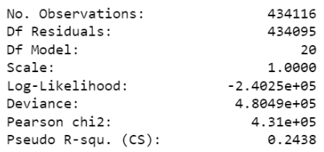
Model Result - Performance
Deviance and Pearson Chi-Square:
The Deviance is 4.8049e+05, and the Pearson chi-square is 4.31e+05.
These values are indicators of the goodness-of-fit of the model. Lower values suggest a better fit.

Slide 27
Feature Interpretation - Part 1
Strong Influence:
HEMOGLOBIN1 (2.3557):
Positive coefficient indicates a strong positive impact on the log-odds.
Individuals with higher hemoglobin levels are more likely to belong to the positive class.
MCV1 (2.3362): increase risks if positive
Positive coefficient suggests a strong positive impact.
Higher mean corpuscular volume increases the odds of being in the positive class.
MPV1 (0.4637):
Positive coefficient indicates a strong positive influence.
Increased mean platelet volume correlates with higher odds of the positive class.

Slide 28
Feature Interpretation - Part 2
Moderate Influence:
NEUTROPHILPCT1 (0.2174):
Positive coefficient suggests a moderate positive impact.
Higher neutrophil percentage moderately increases the odds of the positive class.
NEUTROPHILABS1 (0.4609):
Positive coefficient indicates a moderate positive influence.
Increased absolute neutrophil count moderately raises the odds of the positive class.
LYMPHOCYTEABS1 (0.2163):
Positive coefficient suggests a moderate positive impact.
Higher absolute lymphocyte count moderately increases the odds of the positive class.

Slide 29
Feature Interpretation - Part 3
Small Influence: lower, increase the risks of tMNs
WBC1 (-0.5287):
Negative coefficient suggests a small negative impact.
Higher white blood cell count decreases the odds of the positive class.
RBC1 (-1.3680):
Negative coefficient indicates a small negative influence.
Higher red blood cell count decreases the odds of the positive class.
HEMATOCRIT1 (-1.2158):
Negative coefficient suggests a small negative impact.
Higher hematocrit levels decrease the odds of the positive class

Slide 30
Feature Interpretation - Part 4
Other Influences:
RDWSD1 (-0.3271):
Negative coefficient indicates an influence, but it might be of smaller magnitude.
Binary Features (Married, Female):
Positive (Married) and negative (Female) coefficients suggest influences, but the magnitudes are smaller compared to continuous variables.
AgeatEncounter (0.6762):
Positive coefficient indicates a strong positive impact.
Higher age at encounter significantly increases the odds of the positive class.

Slide 31
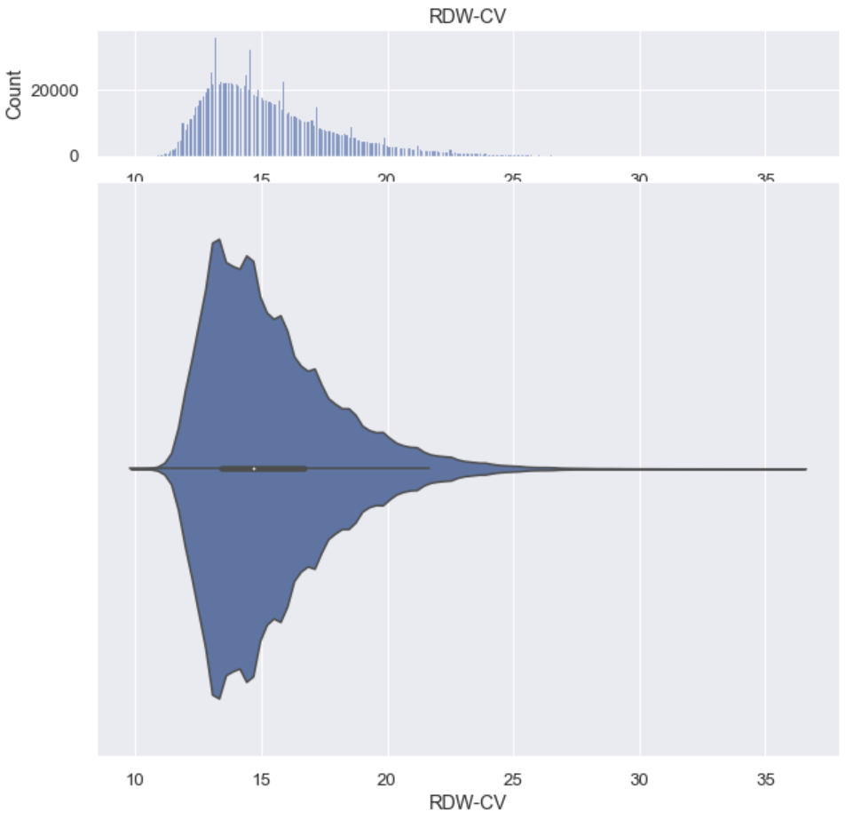
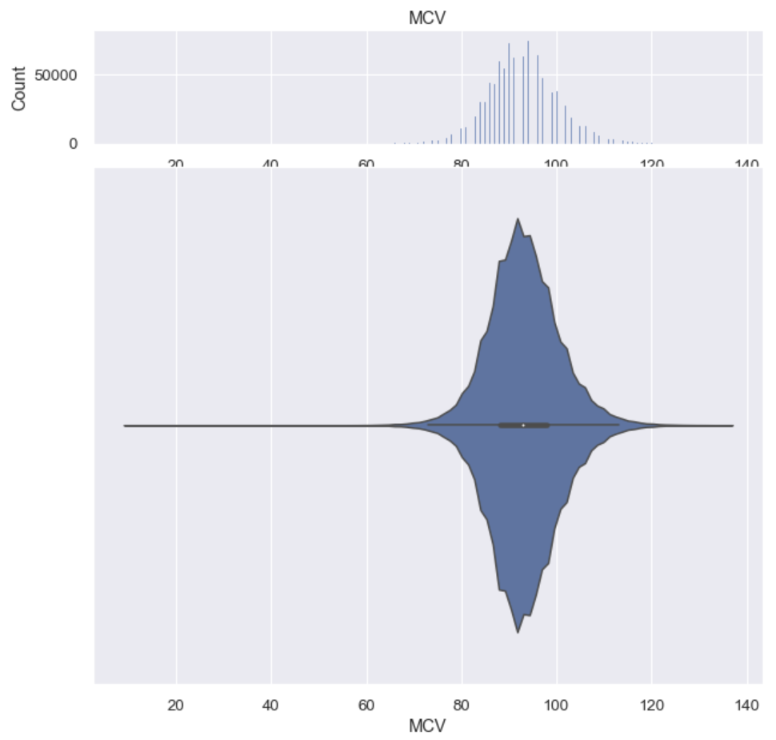
Abnormal Pattern Elements

Slide 32
Feature Importance
Most significant factors:
The foremost factor, MCV-1, bears a weight five times greater than the third most important factor. It has the most substantial influence on the final outcome.
HGB -1 is the second-best influencing factor

Slide 33
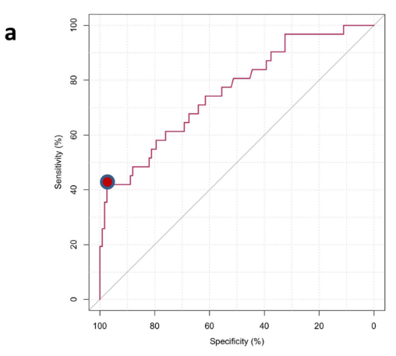
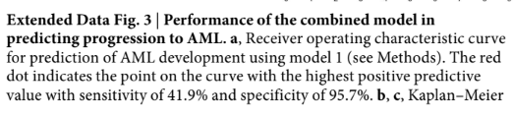
Model Comparison
Model 1 (from article): The ROC curve indicates a point with sensitivity of 41.9% and specificity of 95.7%.
Model 2 (Our model): The ROC AUC is 0.783, and additional metrics are provided (precision, recall, and F1-score).
Because True positive more important in this case, our model is out-performing the model
Notes:
We capture the pattern better
If minimizing false positives is crucial, the model with higher specificity might be preferred;
if detecting all positive cases is more critical, a model with higher sensitivity might be favored.
In our case, we need to correctly identifying the positive cases

Slide 34
End

Slide 35
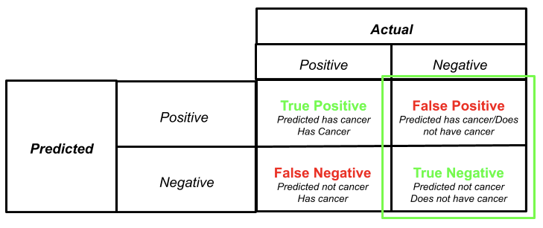

Slide 36
Interpretation of AUC:.
A value of 0.783 suggests that the model has a reasonably good ability to discriminate between positive and negative instances.
Performance Benchmarks:
While there's no universal rule, you can use the following general benchmarks for interpreting AUC:
0.5 to 0.6: Poor
0.6 to 0.7: Fair
0.7 to 0.8: Good
0.8 to 0.9: Very good
0.9 to 1.0: Excellent

Slide 37
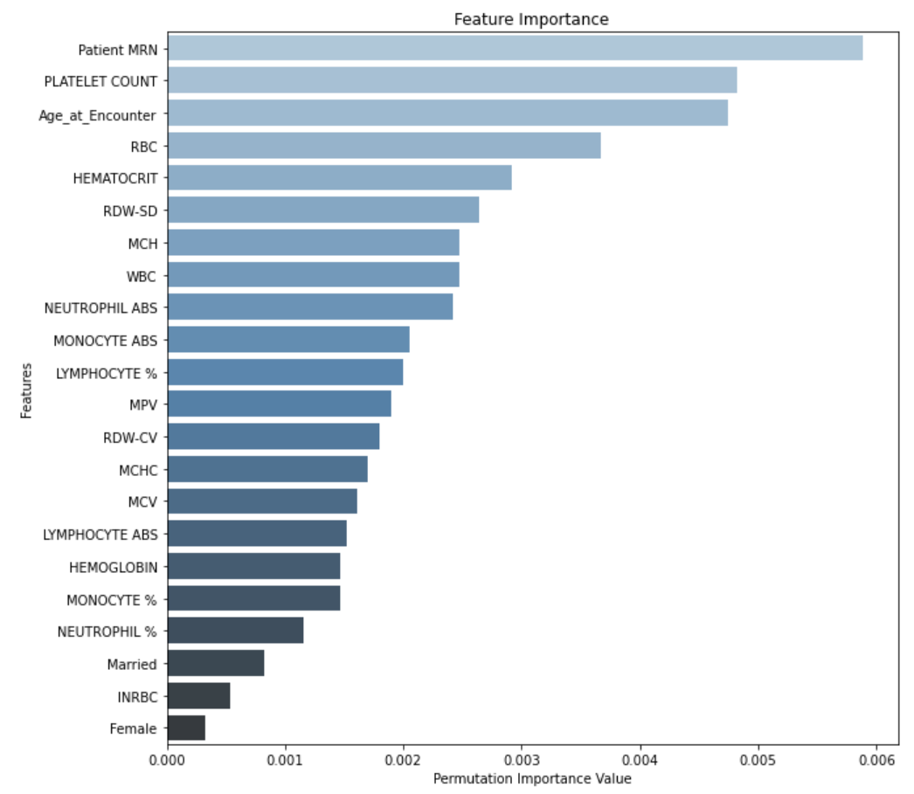
Predictor Weight Importance
Capture non-linear relationships:
Non-linear relationships between features and y that are not fully capture by correlation alone
Multicollinearity:
Affect model differently from correlation which merely use pairwise relationships
Features interactions
Capture interactions between features, where the combined effect of two or more features affects the target differently than the individual effects. combined effects on y
Higher noise sensitivity
Correlation might be sensitive to noise or outliers in the data, while permutation importance tends to be more robust.
If a feature has a strong impact on model performance, permutation importance would be likely to reflect the weight more reliably.

Slide 38
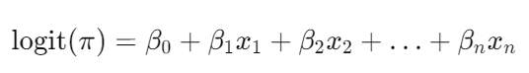
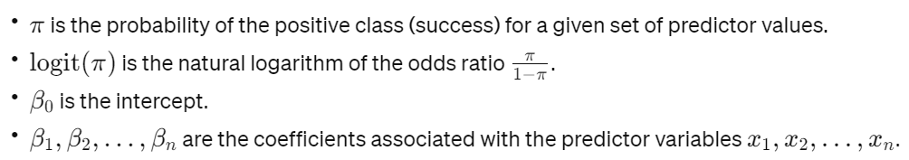
GLM Model Selection
GLMs are particularly useful when the assumptions of classical linear regression are not met, such as when dealing with non-normally distributed and heteroscedastic data or when modeling binary outcomes.
Interpretability: The coefficients in GLMs provide interpretable information about the impact of predictors on the probability of the outcome.
Probabilistic Predictions: GLMs naturally output probabilities, allowing users to make probabilistic interpretations of classification results.
Flexibility: GLMs can be adapted to handle different types of response variable distributions, making them versatile for various data types.
The generalized linear model (GLM) relates the linear predictor to the mean of the response variable through a link function. For binary logistic regression, a common type of GLM used for classification problems, the model can be expressed as follows:

Slide 39
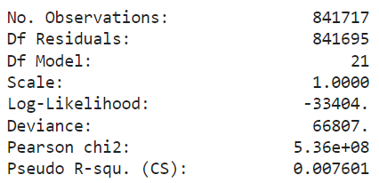
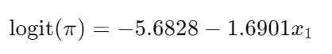
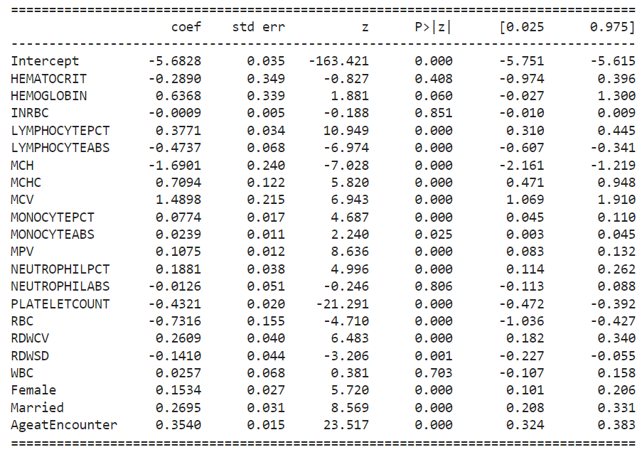
GLM Model Result (Original)
So, for logistic regression, the log-odds of the probability of the positive class is modeled as a linear combination of the predictor variables.
If we have a specific set of coefficients like
β0=−5.6828 and β1(MCH) = -1.6901, it means the logistic regression model for the data is:
Intercept (β0): When all predictor variables are zero, the log-odds of the positive class is
−5.6828.
Coefficient for x1(β1): A one-unit increase in X1 is associated with a −1.6901 decrease in the log-odds of the positive class.
To interpret the coefficients, we can exponentiate them to obtain odds ratios. For example, e^(-1.6901) would give us the odds ratio associated with a one-unit increase in X1

Slide 40
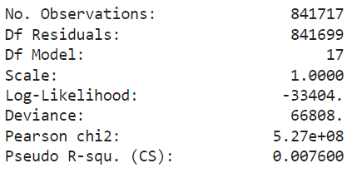
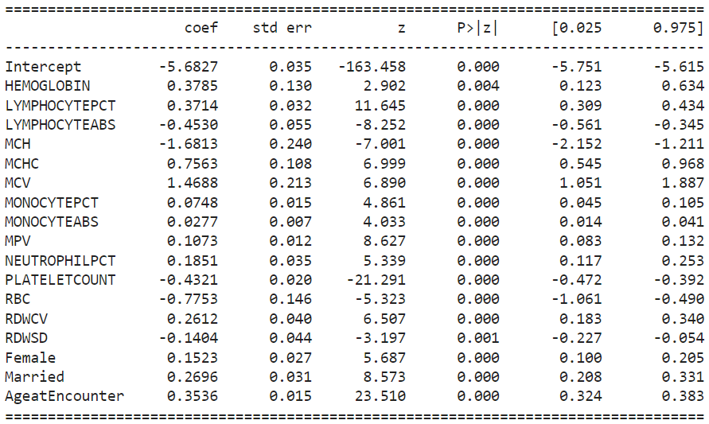
GLM Model Result (Improved)
Remove features that shades a negative impact on model performance
Remove INRBC
Remove NEUTROPHILABS
Remove WBC
Remove HCT
Model interpretation
- Coefficients and factor influences weight
Positive X1 Effect:
If X1 represents a variable that is measured in units (e.g., MCV), then for each additional unit increase in X1​, the odds of the positive class occurring are e^1.4898 times higher.
Strength of Association:
The magnitude of the odds ratio can also indicate the strength of the association between X1 and the positive class.
An odds ratio greater than 1 suggests a positive association, while an odds ratio less than 1 suggests a negative association.
Direction of Impact:
The sign of the coefficient (β1) indicates the direction of the impact. A positive coefficient means that an increase in X1 is associated with an increase in the log-odds of the positive class.

Slide 41
Result (Continue)
1. Precision:
The precision is the ratio of correctly predicted positive observations to the total predicted positives. A high precision indicates that when the model predicts a positive class, it is likely to be correct.
2. Recall (Sensitivity or True Positive Rate):
Recall is the ratio of correctly predicted positive observations to the total actual positives. A high recall for class 0 indicates that the model is good at identifying true positives for that class, while a low recall for class 1 suggests that the model misses many actual positives for that class.
3. F1-Score:
The F1-score is the weighted average of precision and recall. It is a balance between precision and recall. A high F1-score indicates a good balance between precision and recall.
4. Accuracy:
Overall accuracy is the ratio of correctly predicted observations to the total observations. In this case, the model accuracy indicating that it correctly predicts the class for of the result percent of the samples.
5. Macro Avg:
The macro average calculates the metric independently for each class and then takes the unweighted average. In this case, it provides an average precision, recall, and F1-score across both classes.
6. Weighted Avg:
weighted average calculates the metric for each class and then takes the average, weighted by the number of samples in each class. It provides an overall average that gives more importance to the class with more samples.

Slide 42
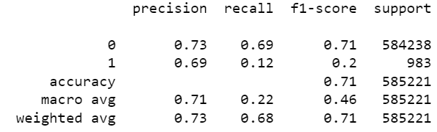
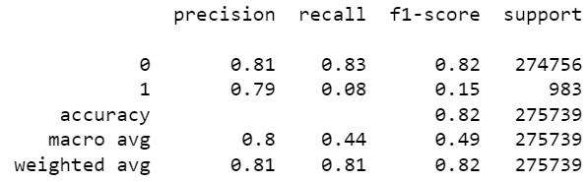
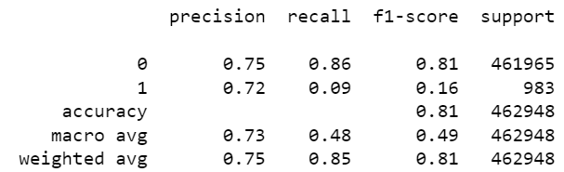
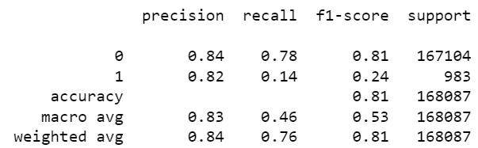
Result
11/9
11/21
11/16
11/26

Slide 43
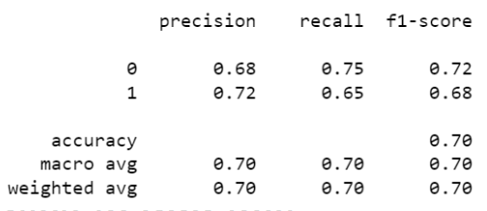
LR
~70%

Slide 44
lr - Feature Importance
Most significant factors:
The foremost factor, MCV-1, bears a weight five times greater than the third most important factor. It has the most substantial influence on the final outcome.
HGB -1 is the second-best influencing factor

Slide 45
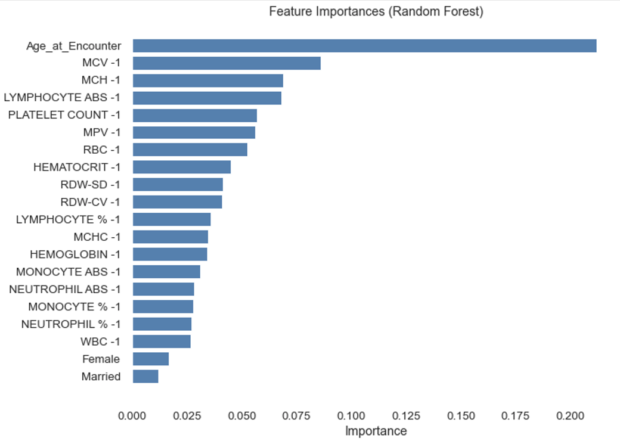
RF
features make more sense than rf
MCV and MCH, more meaningful features taking the weights.
HGB going down

Slide 46
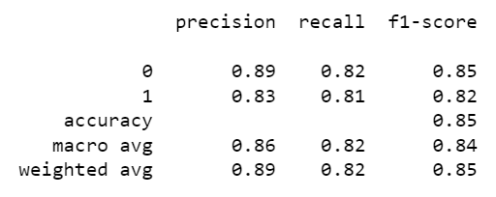
RF
~80-90%

Slide 47

rf
sensitivity-specificity

Slide 48

auc-roc

Slide 49
add on background for article comparisons
expense decrease

Slide 50
Precision
The precision represents the ratio of correctly predicted positive observations to the total predicted positives. A high precision indicates that when the model predicts a positive class, it is likely to be correct.

Slide 51
Recall
Recall (Sensitivity or True Positive Rate):
Recall is the ratio of correctly predicted positive observations to the total actual positives. A higher recall indicates that the model is better at identifying true positives for that class. It measures the ability of the model to capture all the positive instances.
Precision-Recall Tradeoff
The precision-recall tradeoff arises because increasing one of these metrics often leads to a decrease in the other.
Lowering the threshold increases the number of instances predicted as positive, which can increase recall but may also introduce more false positives, reducing precision.
Raising the threshold leads to fewer positive predictions, potentially increasing precision but at the cost of missing some positive instances, reducing recall.

Slide 52
F1 Score
F1 score is a useful metric when there is an uneven distribution between the classes, and both false positives and false negatives need to be considered. It helps strike a balance between precision and recall, providing a single value that summarizes the performance of a classification model.

Slide 53
Support
Cutting Out
Broken records
Null values
Falsely calculated results
Non-informative features
Noise

Slide 54

Proportion of Target Patient Group (Latest)
Reason for group 1 performance vs group 0 performance differences
Same feature, same database, same patient source, but too small proportion for model to learn

Slide 55
Future Plans
Because you suggest we only use the available data in EPIC, following with your instruction and advice, I plan to adapt the following methods to improve the modeling result, including:
Algorithm (4 alternatives)
Change factors/variables
Change the weighting of factors/variables
Punishment of false prediction of case 1
After improving the overall result of base model, going in more in depth for other models

Slide 56

12.4 Report

Slide 57

Data - Part 1 - non-genetic data

Slide 58

Data - Part 2 - non-genetic data

Slide 59

Data - Part 3 - non-genetic data

Slide 60

Key columns related to Sediment Plot - Part 1

Slide 61


Key columns related to Sediment Plot - Part 2
We have no risk scores to references in our database

Slide 62
Key Columns - Part 1:
TPL_type: Indicates the type of treatment, possibly referring to a specific therapy or protocol.
Date_LF: Represents the date of the last follow-up for the patient, providing the end point for the observation period.
TPL_Art: Indicates the type of treatment related to art (possibly an abbreviation), likely associated with the treatment protocol.
TPL_date: Date associated with the TPL treatment.
TPL_Phase: Indicates the phase of TPL treatment.
Time_Diag_TPL: Time from diagnosis to the start of TPL treatment.
Time_1CR_TPL: Time from the first complete remission (CR) to the start of TPL treatment.
cuminc: Cumulative incidence of a specific event.
rfsstat_allo: Recurrence-free survival status specific to allo (possibly allogeneic treatment).
rfs_allo: Recurrence-free survival time specific to allo.
cuminc_allo: Cumulative incidence specific to allo. （bone marrow transplant）

Slide 63
Key Columns - Part 2:
CR_date: Date of achieving complete remission (CR).
Recurrence_date: Date of recurrence after initial treatment.
Post_Induction_Therapy_Remission: Indicates whether the patient achieved remission after post-induction therapy.
Status: Overall clinical status or outcome.
OS (Overall Survival): Survival time from a specific time point, often diagnosis.
EFSSTAT: Event-free survival status.
ereignart: Type of event (e.g., death, recurrence) leading to an event-free survival.
efs: Event-free survival time.
rfsstat: Recurrence-free survival status.
rfs: Recurrence-free survival time.

Slide 64

Questions related to TPL columns
What are the TPL_type?
FREMD meaning?
Why separate as FREMD and ALLO treatment?
We need to change these part as tMN related disease or tMN itself

Slide 65
Data Problems:
Relapse:
Too many categories and variety we could not capture one by one
Around 550,000 records
Unless we target the exact same disease name, since it would be different for every cancer patient.
In the article, it is always related to AML, and set AML categories so they can target the exact keyword
We have no risk scores to references in our database
multi-stage prediction model

Slide 66
Replicate Design - Part 1
TPL_type:
This is a categorical variable indicating the type of treatment. There isn't a specific formula for this; it's a classification based on the type of treatment received.
Date_LF:
This is the date of the last follow-up and is recorded as a specific date.
TPL_Art:
Similar to TPL_type, it is a categorical variable indicating the type of treatment related to art.
TPL_date:
Date associated with the TPL treatment. It is recorded as a specific date.
TPL_Phase:
Indicates the phase of TPL treatment. This is typically a categorical variable.
Time_Diag_TPL:
Time from diagnosis to the start of TPL treatment
Time_Diag_TPL=TPL_date−Diagnosis_date
Time_1CR_TPL:
Time from the first complete remission (CR) to the start of TPL treatment.
Time_1CR_TPL=TPL_date−CR_date

Slide 67
Replicate Design - Part 2
8. CR_date:
Date of achieving complete remission (CR)
(If resolved date is not null).
9. Recurrence_date:
Date of recurrence after the initial treatment. It is recorded as a specific date.
(if the ICD or diagnosis ever occur, more than once)
10. Post_Induction_Therapy_Remission:
Indicates whether the patient achieved remission after post-induction therapy. (Remission - Resolved Date)
11. Status:
Overall clinical status or outcome (no specific matched explanations).
12. OS (Overall Survival):
Survival time from a specific time point, often diagnosis.
OS=Date(alive)−First Cancer Diagnosis_date (first)

Slide 68
Replicate Design - Part 3
13. EFSSTAT:
Event-free survival status. This is typically a categorical variable.
(Survive after cancer, no tMN development)
14. ereignart:
Type of event (e.g., death, recurrence) leading to an event-free survival.
(Death, remission or survive after cancer without remission)
15. efs:
Event-free survival time.
efs = Date (today) − First Cancer Diagnosis_date
16. rfsstat:
Recurrence-free survival status.
（No relapse, no same diagnosis occurs)

Slide 69
Replicate Design - Part 4
17. rfs:
Recurrence-free survival time.
rfs=Recurrence_date（if recurrence exist）−Diagnosis_date
18. cuminc:
Cumulative incidence of a specific event. Calculated using Kaplan-Meier or cumulative incidence functions.
19. rfsstat_allo:
Recurrence-free survival status specific to allo (allogeneic hematopoietic cell transplant (allograft))
20. rfs_allo:
Recurrence-free survival time specific to allo.
rfs_allo=Recurrence_date−Allo_Treatment_date
21. cuminc_allo:
Cumulative incidence specific to allo. Calculated using Kaplan-Meier or cumulative incidence functions for events related to allo treatment.

Slide 70
Model Design Process
Start with what data we have
According to the data traits and distributions, we pick the model
Run the appropriate model and optimize model results
Choose a Model:
Consider the nature of the problem (classification etc.).
Consider the size of the dataset.
Choose models based on the characteristics of your data (linear models for linear relationships, tree-based models for non-linear relationships, etc.)

Slide 71
Data Problems
Since we have none of the 23 key columns in the article’s data set, we need to replicate and create all the key columns by ourselves.
We have very messy raw data and have none of the key categories they are using in our database.
Specifically:
We can see a patient dead, but no mark reason of dead. So we need to make assumption that patient dead from the disease before the death date
We assume relapse will use the exact same disease name from before
We assume the closest date we can get represent the true status of the corresponding cancer and disease.
No clear grouping or differentiation showed in the article.
No specific time recorded for relapse and remission.
No risk factors we can evaluate our patients for.

Slide 72
Data Traits
Dataset in the article:
time specific columns features
classifications for different disease and capture all the situations
Anderson data:
not much time columns to replicate multiple disease classifications probability variation results.
Cannot be captured for all cancer cases and would not be a unified result

Slide 73
Additional Features Design
Inherited, behavioral/lifestyle, environmental risk factors and comorbid conditions:
tMN several blood indicators do not change
Age, background disease, gender, allergy (Inherited)
Smoking, germline variation, obesity (BMI) (disease related), blood pressure (Unhealthy lifestyle)
Chemotherapy type, frequency and time, and the relevant medication usage. (Chemical factor/inducement)
Relevant diseases related to Hematopoietic stem cells (HSCs) change or CHIP early stage before Leukemia (Propagating inflammation, accelerating cardiovascular disease, co-morbidities, hematologic cancers, atherosclerotic cardiovascular diseases, inflammatory conditions, premature menopause, HIV)

Slide 74

1. Non-remission Death:
Death without remission from their own cancer
all cancer patients
can first dead from their own cancers
2. Non-relapse deaths:
remission from their own cancer but die from other cancer or diseases (Non-tMN diseases)
cancers can be in remission, but dead from other possibilities
3. Relapse death
develop Tmn LATER
REPLAP IS TMN, and dead from tMN
what is their chances of diagnosis
when would they die from tmn
4. did not develop and alive (could be middle process)
5. alive without complete remission
cancer still active but did not dead,
and no tMN development

Slide 75

time component

Slide 76


Slide 77
Problems
dead, not chance of develop the tMNs
competing risk
don’t develop
dead too early
or really don’t have a tMN
multi-stage model
get a first chemotherapy, proabbility of achieve remission or not and dead
once remission, relapse in the future. Dead from other disease.
dead from relapse
two years later, the chance of alive that disease leukemia comes abck as a replapse
chance from leukemia coming back

Slide 78
did not develop and alive
alive without complete remission
cancer still active but did not dead,
and no tMN development

Slide 79


Slide 80


Slide 81
1. Non-remission Death:
Death without remission from their own cancer
all cancer patients
can first dead from their own cancers
2. Non-relapse deaths:
remission from their own cancer but die from other cancer or diseases (Non-tMN diseases)
cancers can be in remission, but dead from other possibilities
3. Relapse death
develop Tmn LATER
REPLAP IS TMN, and dead from tMN
what is their chances of diagnosis
when would they die from tmn
4. did not develop and alive (could be middle process)
5. alive without complete remission
cancer still active but did not dead,
and no tMN development

Slide 82


Slide 83
tree diagram
as a track
grouping different

Slide 84
Source
Precision oncology for acute myeloid leukemia using a knowledge bank approach
Article: https://www.nature.com/articles/ng.3756#Sec15
Calculator: https://www.nature.com/articles/ng.3756#Sec15
Github: https://github.com/mg14/aml-multistage

Slide 87
Cuminc
variable cuminc in a clinical dataset likely refers to "cumulative incidence" or a similar concept
Cumulative incidence of relapse: The probability of experiencing a relapse over time.
Cumulative incidence of death: The probability of dying from any cause over time.
The cumulative incidence function provides a more accurate estimate of event probabilities in the presence of competing risks compared to traditional survival analysis techniques.
The variable cuminc itself may represent the cumulative incidence at a specific time point or cumulative incidence over a range of time points.
But the dataset didn’t indicate how long the time period is.

Slide 88
rfs
refers to "Relapse-Free Survival."
a value of 2065 could mean that a patient experienced relapse after 2065 days from a certain starting point, and a value of 171 could mean another patient experienced relapse after 171 days.

Slide 89

Factor - Age

Slide 90

Factor – RDW-SD

Slide 91

Factor - MPV

Slide 92

MCV

Slide 93


Slide 94
Result (Continue)
1. Precision:
The precision is the ratio of correctly predicted positive observations to the total predicted positives. A high precision indicates that when the model predicts a positive class, it is likely to be correct.
2. Recall (Sensitivity or True Positive Rate):
Recall is the ratio of correctly predicted positive observations to the total actual positives. A high recall for class 0 indicates that the model is good at identifying true positives for that class, while a low recall for class 1 suggests that the model misses many actual positives for that class.
3. F1-Score:
The F1-score is the weighted average of precision and recall. It is a balance between precision and recall. A high F1-score indicates a good balance between precision and recall.
4. Accuracy:
Overall accuracy is the ratio of correctly predicted observations to the total observations. In this case, the model accuracy indicating that it correctly predicts the class for of the result percent of the samples.

Slide 96
Department Name
[Month] 2023 Team Meeting
Speaker name
Speaker title
Contact info: Contact@MDAnderson.org

Slide 97
Agenda
TEAM UPDATES
Introductions/Departures
Promotions
Service Awards
REVIEW TEAM GOALS
Updates and progress
INSTITUTIONAL NEWS
What’s going on
How it affects us
DISCUSSION
Q&A
CLOSING
Plans for next meeting

Slide 98
Team Updates

Slide 99
Title and Content slide layout
First-level text auto format
Second-level text auto format
Third-level text auto format
Fourth-level text auto format
Decrease List Level to get back to a previous text level if needed

Slide 100
tMN Patients vs. Cancer Patient - Lab Result Elements Preliminary Analysis Overview
Zijun Wu
Data Patterns and Trend Visualization Reports
Nov 6, 2023

Slide 101
Agenda
Problem Statement
Data Profile
Data Processing
Data problems and difficulties & solutions
19 features introduction
General Tendency and Individual Images
Proposed Solution and Model Selection
Conclusion & Future Steps
101
Notes:
Of my presentation

Slide 102
Problem Statement
tMN prediction is a race of time
0.5%-1% cancer will become tMN patients, the longest latency could be 7 years.
tMN Is a race of time to predict the acute disease before
As the potential patients approaching to the critical transition point, more signs are showing on their body, but they becoming more and more vulnable to the transition to tMNs.
The primary objective of analyzing this dataset is to understand the hematological profiles of patients, particularly in relation to the diagnosis of tMN.
This involves exploring trends, patterns, and potential indicators within the hematological parameters leading up to the diagnosis date.
The lab data provides a high-level overview of the data, including patient information, hematological parameters, and temporal aspects, setting the stage for further exploration and analysis.
Find out how to target these tMN patients before the
Therapy related leukemia progresses rapidly, and patients may face a life-threatening situation within a month.
Devise a time-efficient prediction model capable of delivering predictive outcomes prior to diagnosis
Notes:
the onset of therapy-related leukemia in potential tMN patients.
A race of time

Slide 103
Data Profile
The dataset comprises 48,732,425 records capturing diverse hematological parameters across numerous patient encounters.
Each record provides insight into a patient's health status based on hematological measurements during a specific encounter.
Time-based information allows for the exploration of how hematological parameters relate to the diagnosis date and the time intervals leading up to the diagnosis.
Data Dimension | Descriptions
Data Variables | from 97,000 cancer patients, including 217 tMN patients
Data Size | 5 million records after cleaning duplicates
Data Type | Time-based numerical data, categorical data
Target | 19 categories hematological parameters
Notes:
Data introduction

Slide 104
Pre-Data Processing
Data Problems:
1. No CHIP category, filtering out using indicators or other features
2. Don’t have much before and after chemotherapy indicator differences or comparison (lack of relevant key features)
3. Dates of each leukemia treatment
Multi-layer filtering to get tMN patients.
No classification of tMN patients. Filtering out based on conditional filtering on 514600 diagnosis records.
Get 217 out of
Create relevant key features

Slide 105
Difficulties
Limited Temporal Data:
Dynamic Nature of the Disease:
Rapidly progressing diseases often have a short timeframe between diagnosis and critical events (e.g., death).
This results in a limited amount of temporal data available for model training and challenges to capture the dynamics of disease progression adequately.
Rapidly progressing diseases can exhibit dynamic and unpredictable patterns, making it difficult to model and predict the disease trajectory accurately.
Changes in patient condition may occur rapidly, and capturing these nuances in the data is challenging.
Imbalanced Data:
Limited Feature Stability:
The dataset may be imbalanced, with a small number of instances representing the critical events (e.g., death) compared to non-critical events.
This imbalance can affect model performance, as the algorithm may be biased towards predicting the majority class.
Features that are relevant early in the disease progression might lose their significance as the disease advances.
Identifying stable features that provide consistent predictive power throughout the progression becomes a challenge.

Slide 106

WBC

Slide 107
Review Team Goals

Slide 108
Our Goals
First-level text auto format
, while a low recall suggests that the model misses many actual positives for that class

Slide 109
Institutional News

Slide 110
What’s going on around us
[Pull info from Leadership Communications Toolkit and Inside News]
How this affects you

Slide 111
Discussion

Slide 112
Next Meeting
Day of the week and date
Time
Location

Slide 113

Tips and templates to help you communicate effectively at MD Anderson.
Find more resources in the Leadership Communications Toolkit at www.inside.mdanderson.org

